Slide 1


MRF TYRES FINANCIAL ANALYSIS REPORT
~ Under Supervision of: Prof. Niranjan Swain

Slide 2

Introduction
Financial Ratio Analysis involves evaluating relationships between different pieces of financial data in financial statements to understand a company's performance and financial health.
Key Financial Ratios
3
Liquidity Ratios
4
2
Efficiency Ratios
Solvency Ratios
5
Profitability Ratios
Market Ratios
1

Slide 3
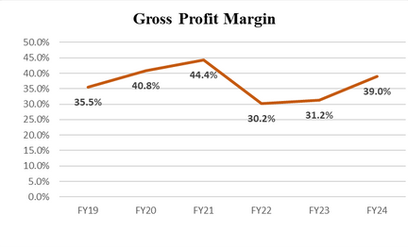
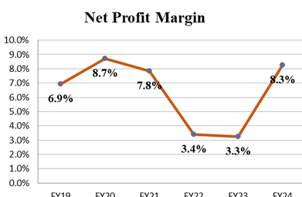
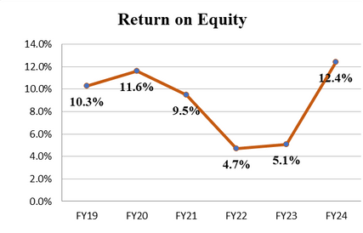
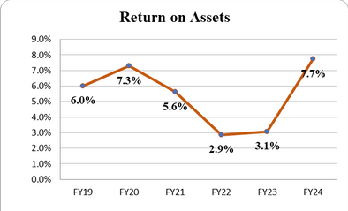
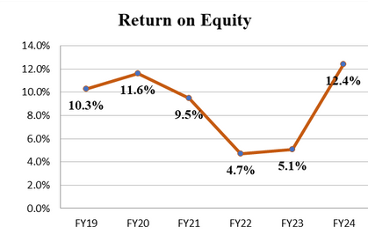
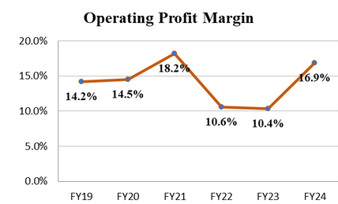
Profitability Ratios
Gross Profit Margin
Operating Profit Margin
Net Profit Margin
Return on Assets
Return on Equity
 |  | Trend: Shows a peak in FY20, then a sharp decline in FY21 and FY22, followed by a recovery in FY23 and FY24. Interpretation: Gross profit margin illustrates how much a company earns after deducting the costs associated with making and selling its products. The high margin in FY20 suggests efficient cost management or strong sales pricing. The subsequent drop could be due to increased costs or reduced pricing power, while the recovery indicates an adjustment to regain profitability.
 |  | Trend: Peaks in FY20, declines through FY22, then rises again by FY24. nterpretation: This margin reflects the company's ability to control operating expenses. The initial high performance indicates good operational control, but the decline suggests rising costs or falling sales efficiency, which later improvements suggest mitigation of these issues.
 |  | Trend: Similar to the gross profit margin, with a peak in FY20, a significant drop by FY22, and an upward trend thereafter. Interpretation: Net profit margin takes all expenses into account, including taxes, interest, and operating expenses. The volatility reflects broader financial management challenges or external pressures impacting profitability, with a recent recovery suggesting effective adjustments.
 |  | Trend: Declines sharply after FY20 but recovers significantly by FY24. Interpretation: ROA indicates how efficiently profits are generated from the company's assets. The sharp drop may suggest underutilization or inefficient use of assets, while the recovery suggests improvements in asset utilization or profitability.
 |  | Trend: Drops significantly in the middle of the period but sees a strong recovery by FY24. Interpretation: ROE measures how effectively earnings are generated from shareholders' equity. The fluctuating trend indicates variable financial performance and potentially changing equity levels, with recent increases suggesting improved earnings or strategic financial management.
FY19
FY20 FY21 FY22 FY23
FY24
35.5
40.8
44.4
30.2
31.1
39.0
FY19
FY20 FY21 FY22 FY23
FY24
14.2
14.5
18.2
10.6
10.4
16.9
FY19
FY20 FY21 FY22 FY23
FY24
6.9
8.7
7.8
3.4
3.3
8.3
FY19
FY20 FY21 FY22 FY23
FY24
6.0
7.3
5.6
2.9
3.1
7.7
FY19
FY20 FY21 FY22 FY23
FY24
10.3
11.6
9.5
4.7
5.1
12.4
The profitability ratios for the company demonstrate significant fluctuations, with notable challenges in managing costs and maintaining profitability between FY20 and FY22. The recoveries observed in FY23 and FY24 across various metrics suggest successful adjustments in pricing, cost management, and operational efficiency. This rebound is crucial as it indicates the company's resilience and capability to adapt to changing economic conditions or internal inefficiencies.
BITS Pilani, Hyderabad Campus

Slide 4
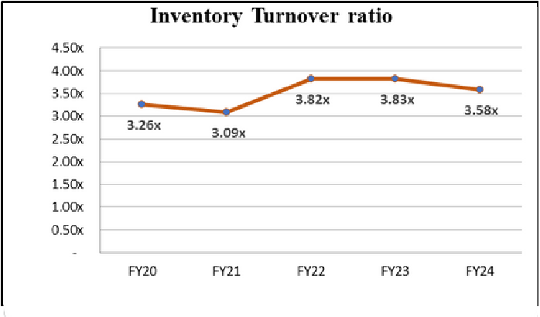
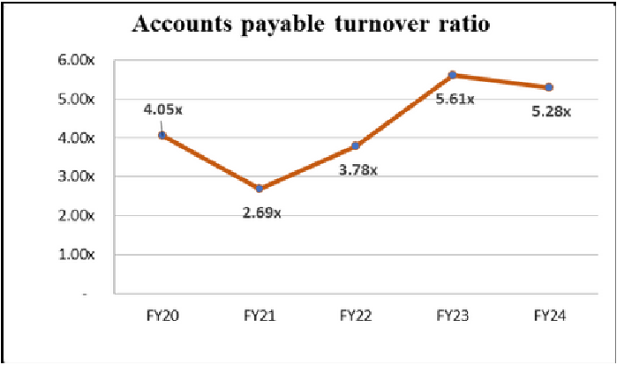
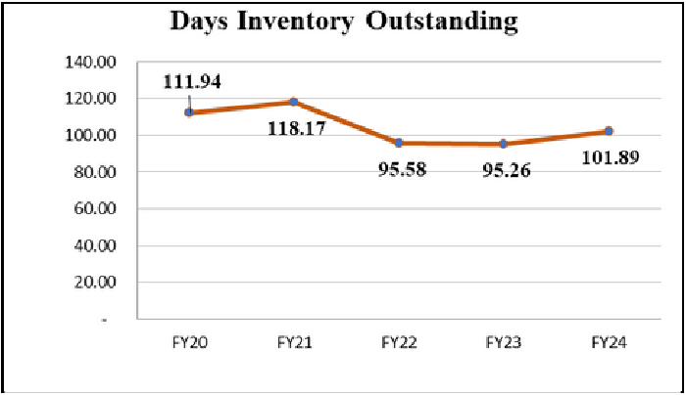
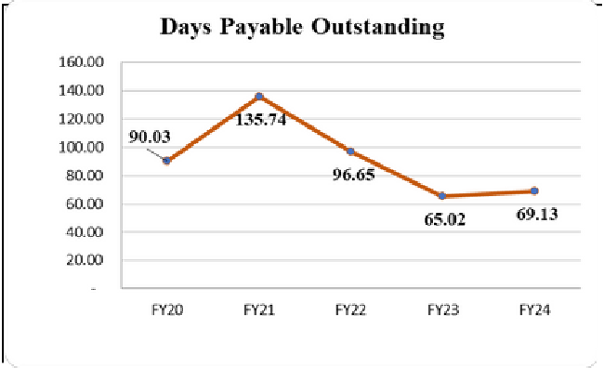
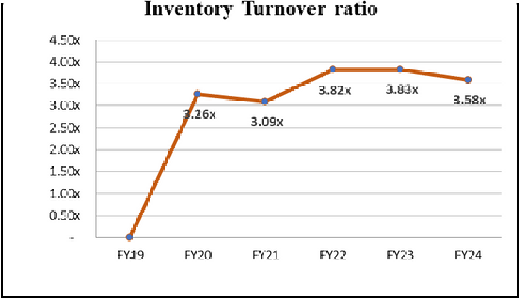
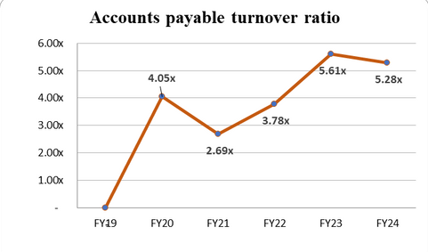
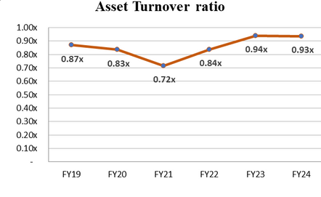
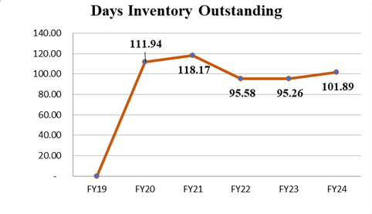
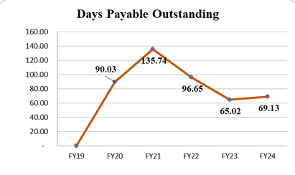
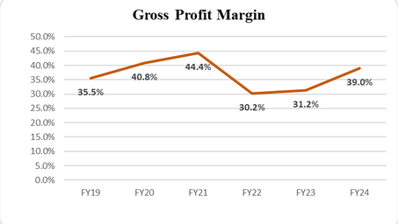
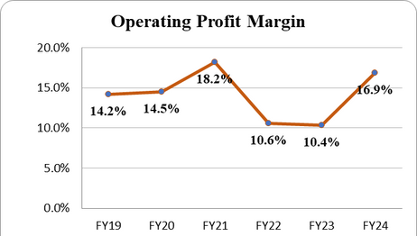
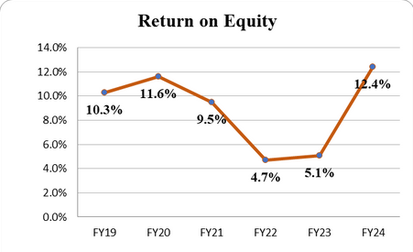
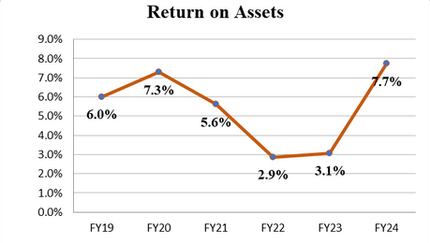
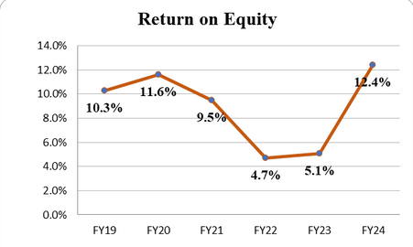

Management Efficiency Ratios:
Inventory Turnover Ratio
Account Payable Turnover Ratio
Asset Turnover Ratio
Days Inventory Outstanding
Days Payable Outstanding
 |  | Trend: Fluctuates initially but shows an overall upward trend towards FY24. Interpretation: This ratio measures how quickly a company sells and replaces its inventory. The overall increase indicates improved efficiency in managing inventory levels, suggesting better alignment of inventory with sales demand.
 |  | Trend: Varied initially, peaking in FY23 before a slight decrease in FY24. Interpretation: This ratio shows how quickly a company pays off its suppliers. The peak in FY23 could suggest quicker payments to suppliers or a change in payment terms, which could be strategic or due to pressure from suppliers. A decrease in FY24 might indicate a return to a more normalized payment cycle.
 |  | Trend: Generally decreasing, indicating improved efficiency. Interpretation: A lower DIO suggests that the company is selling its inventory more quickly, which is beneficial for cash flow and reduces the risk of obsolescence.
 |  | Trend: Initially increases significantly, then starts to decreases. Interpretation: The increase in DPO might indicate the company extended its payment terms with suppliers to retain cash longer. However, the decrease in later years suggests a move towards quicker payments, possibly to take advantage of early payment discounts or improve supplier relationships.
FY19
FY20 FY21 FY22 FY23
FY24
-
3.26
3.09
3.82
3.83
3.58
FY19
FY20 FY21 FY22 FY23
FY24
-
4.05
2.69
3.78
5.61
5.28
FY19
FY20 FY21 FY22 FY23
FY24
0.87
0.83
0.72
0.84
0.94
0.93
Trend: Generally increasing over the period.
Interpretation: This ratio indicates how efficiently a company uses its assets to generate sales. The upward trend suggests that the company is becoming more efficient in using its assets to generate revenue, which is a positive development.
FY19
FY20 FY21 FY22 FY23
FY24
-
111.9
118.2
95.58
9.26
101.9
FY19
FY20 FY21 FY22 FY23
FY24
-
11.6
9.5
4.7
5.1
12.4
The management efficiency ratios indicate that the company has generally improved its operational efficiency from FY19 to FY24. The trends in asset turnover, DSO, and DIO are particularly positive, suggesting more effective use of assets and better management of inventory and receivables. The fluctuations in DPO and CCC indicate strategic adjustments in managing payables and overall cash flow. These improvements are crucial for maintaining a healthy balance sheet and ensuring sustainable growth.

Slide 5
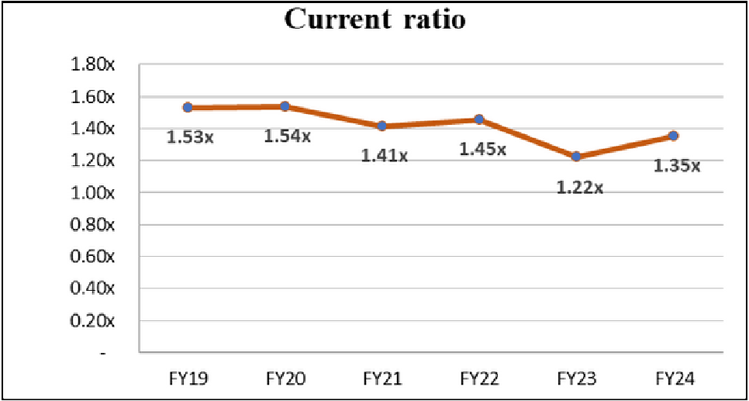
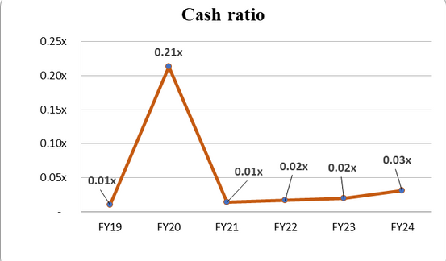
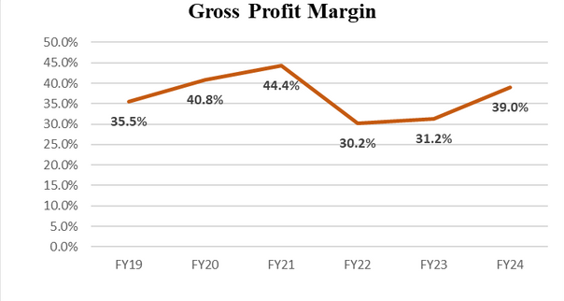
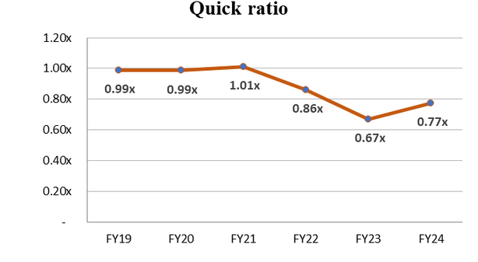
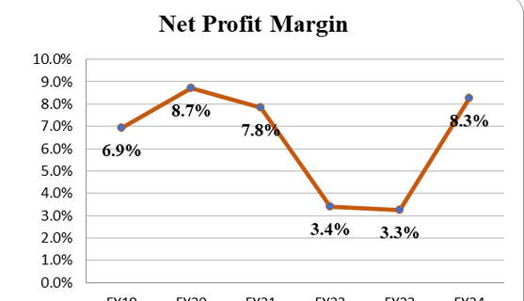
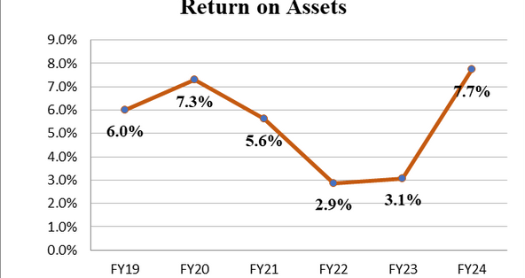
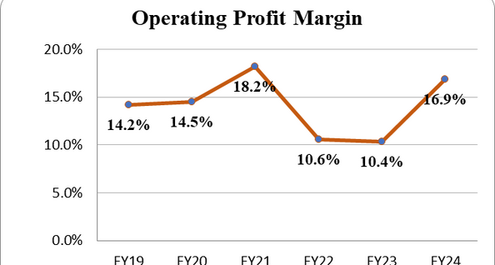
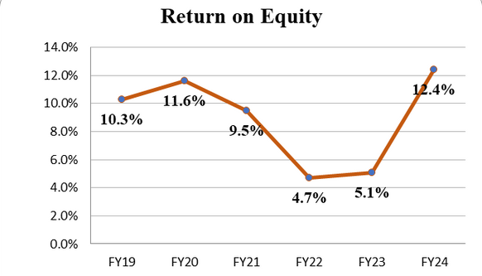
Liquidity Ratios
Current Ratio
Quick Ratio
Cash Ratio
 |  | Trend: Starts around 1.5x, dips to 1.22x in FY23, and then slightly recovers to 1.35x by FY24. Interpretation: The current ratio measures a company's ability to pay off its short-term liabilities with short-term assets. A ratio above 1 is generally seen as healthy. The dip in FY23 suggests a temporary strain in liquidity, possibly due to increased liabilities or reduced liquid assets. The recovery in FY24 suggests an improvement, but it's still not back to the initial levels, indicating ongoing variability in handling short-term obligations.
 |  | Trend: Generally stable around 0.99x, with a dip to 0.67x in FY23, followed by a slight improvement to 0.77x in FY24. Interpretation: The quick ratio excludes inventory from assets and is a stricter test of liquidity. The observed stability indicates a reasonable ability to cover immediate liabilities, but the dip in FY23 and the low recovery in FY24 suggest that the company might have faced challenges in maintaining liquid asset levels sufficient to cover short-term debts without relying on selling inventory.
 |  |  | Trend: Significantly fluctuates, with a notable spike in FY21 to 0.2x, then dropping back to levels around 0.02x to 0.03x. Interpretation: The cash ratio is the most conservative liquidity measure, indicating the ability to cover short-term liabilities with cash and cash equivalents alone. The spike in FY21 might be due to a temporary increase in cash holdings, possibly in response to specific financial strategies or external factors. The return to lower levels suggests that the company does not maintain a high level of cash on hand regularly, which might pose risks if sudden financial needs arise.
FY19
FY20 FY21 FY22 FY23
FY24
1.53
1.54
1.41
1.45
1.22
1.35
FY19
FY20 FY21 FY22 FY23
FY24
0.99
0.99
1.01
0.86
0.67
0.77
FY19
FY20 FY21 FY22 FY23
FY24
0.01
0.21
0.01
0.02
0.02
0.03
The liquidity ratios reveal that while the company generally maintains adequate short-term asset levels to cover liabilities, there was a noticeable strain in FY23. The slight recovery in FY24 in all ratios suggests efforts to improve liquidity, but it has not fully reached earlier stability. The significant fluctuation in the cash ratio particularly underscores the variability in cash holdings, which could be a concern during periods of financial stress. The company may need to focus on improving its liquidity management to ensure stability and readiness for unforeseen financial demands.

Slide 6
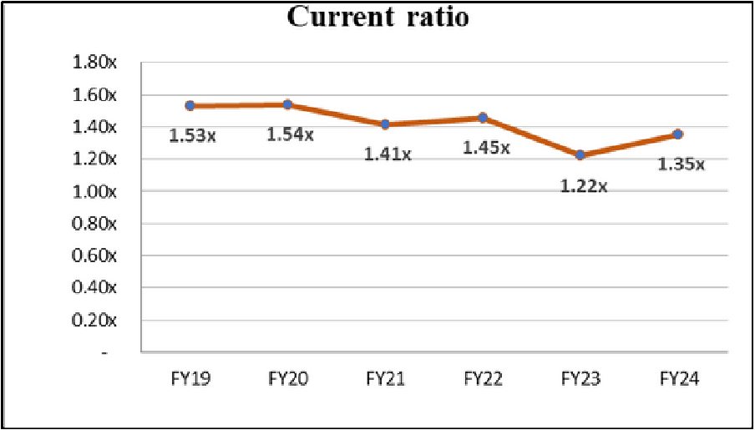
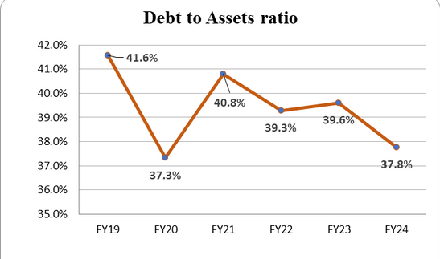
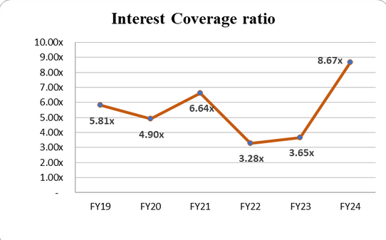
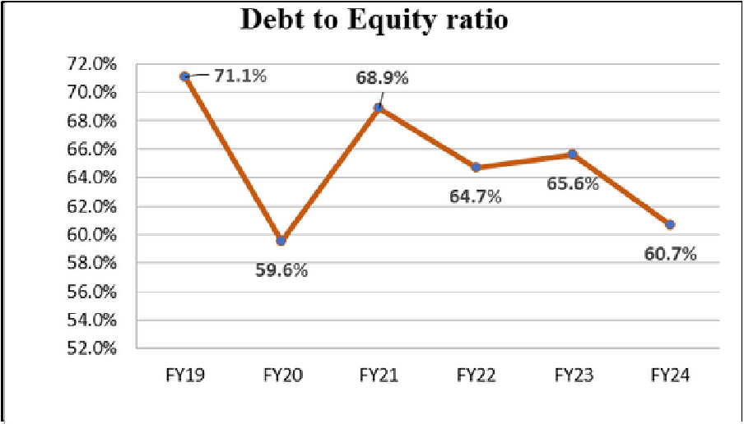
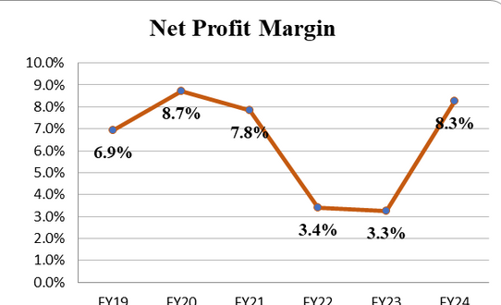
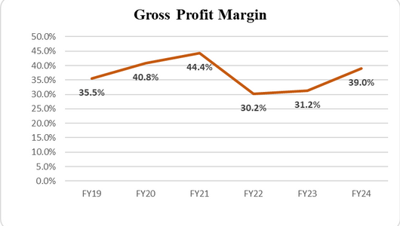
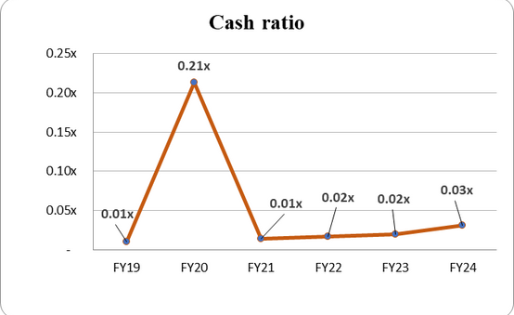
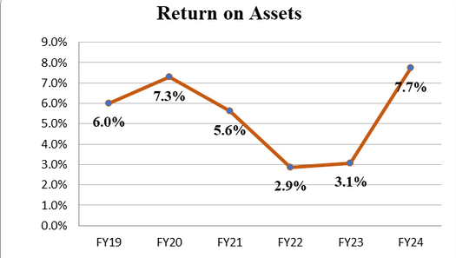
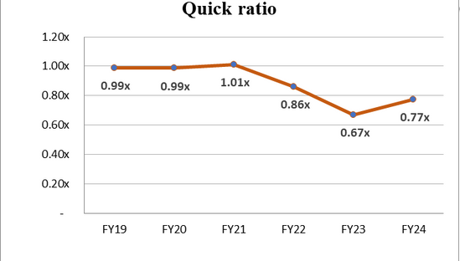


Solvency Ratios
Debt to Equity Ratio
Debt To Assets Ratio
Interest Coverage Ratio
 |  | Trend: Starts at a peak in FY19, shows a general decline through FY21, and stabilizes thereafter with minor fluctuations. Interpretation: The debt to equity ratio indicates the proportion of equity and debt used to finance a company's assets. A decreasing trend generally suggests a reduction in leverage, implying that the company is relying less on debt relative to equity. The stabilization indicates a more consistent financial structure in the later years, possibly reflecting a strategic shift towards a balanced capital structure.
 |  | Trend: The ratio decreases significantly from FY19 to FY21, slightly increases in FY22, and then shows a decrease again by FY24. Interpretation: This ratio shows what percentage of a company's assets is financed by debt. The observed decrease suggests that the company has been reducing its reliance on debt to finance its assets, which can reduce financial risk and potentially increase financial stability.
 |  | Trend: Sees a significant dip in FY21 and FY22 but recovers strongly in FY23 and FY24. Interpretation: The interest coverage ratio is a measure of a company's ability to handle its debt obligations by comparing its earnings before interest and taxes (EBIT) to its interest expenses. The low points in FY21 and FY22 indicate difficulties in covering interest expenses, possibly due to lower earnings or higher interest costs. The subsequent recovery suggests an improvement in earnings or management of debt costs, enhancing the company's ability to service its debt.
FY19
FY20 FY21 FY22 FY23
FY24
71.1
59.6
68.9
64.7
65.6
60.7
FY19
FY20 FY21 FY22 FY23
FY24
41.6
37.3
40.8
39.3
39.6
37.8
FY19
FY20 FY21 FY22 FY23
FY24
5.81
4.9
6.64
3.28
3.65
8.67
The solvency ratios highlight that the company has been progressively reducing its leverage, suggesting a strategic move towards a lower risk financial structure. The initial high debt levels in FY19 were reduced significantly by FY21, with stability thereafter. The fluctuating interest coverage ratio indicates periods of stress in managing interest expenses but shows a robust recovery in the last two years, reflecting possibly improved operational efficiency or earnings growth. These trends suggest a strengthening financial position, but the company should continue to monitor and manage its debt levels and earnings stability to ensure long-term financial health.

Slide 7
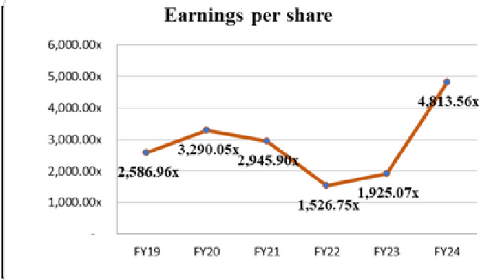
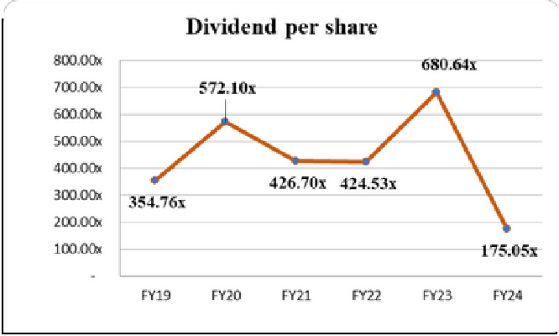
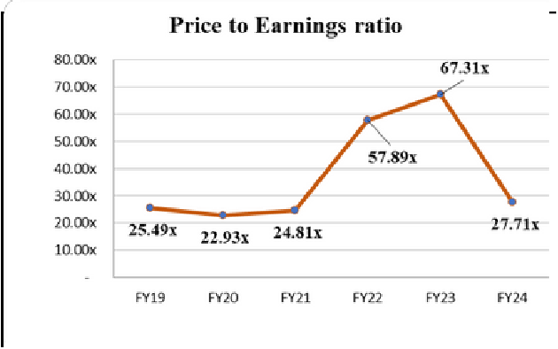
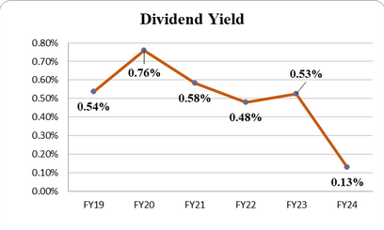
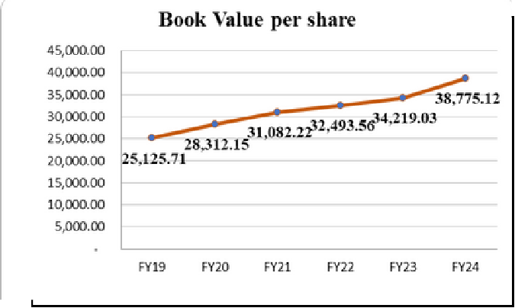
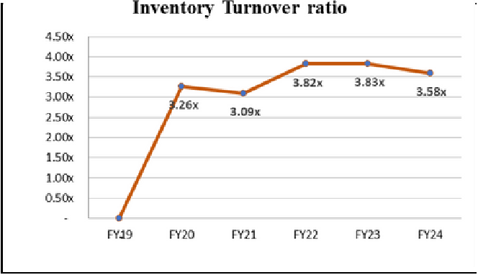



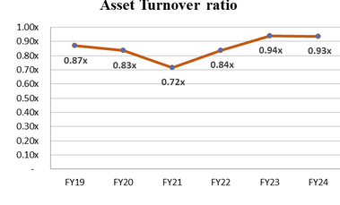
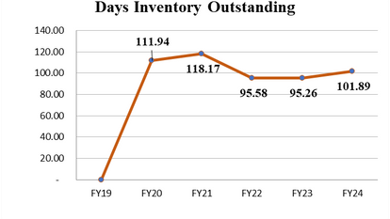
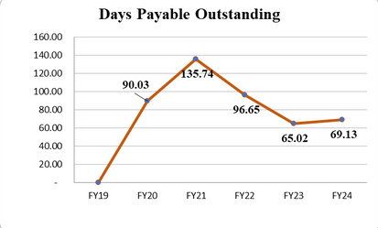
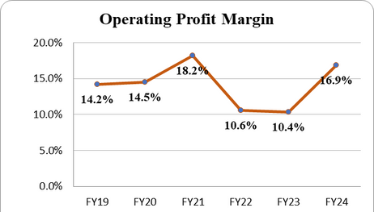
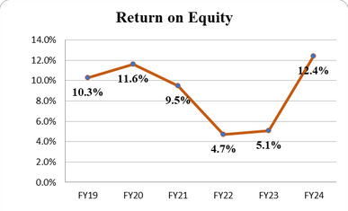

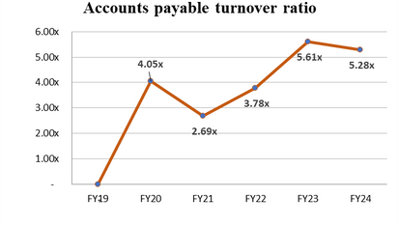
Market Ratios:
Earnings per Share
Dividends per Share
Price to Earning Ratio
Dividend Yield
Book Value per Share
 |  | Trend: Peaks in FY23 and then shows a dramatic decrease by FY24. Interpretation: Dividend yield, which relates dividend payments to the stock price, dropping sharply indicates that the share price has increased disproportionately to dividends or dividends have been reduced significantly. This could reflect a changing investor perception about the company’s future earnings potential or dividend policy.
 |  | Trend: Peaking in FY19 and then generally declining. Interpretation: Dividend yield, which compares the dividend per share to the share price, has declined, indicating that the share price has increased at a faster rate than dividends. This could reflect increased market valuation of the company's stock, which has outpaced the growth in dividends.
FY19
FY20 FY21 FY22 FY23
FY24
2586
3290
2945
1526
1925
4813
Trend: After a decline from FY19 to FY23, there is a sharp increase in FY24.
Interpretation: EPS is a key indicator of a company’s profitability on a per-share basis. The sharp increase in FY24 suggests significant improvement in profitability or reduced number of shares outstanding. The prior decline might have been due to decreasing profits or increased share count.
FY19
FY20 FY21 FY22 FY23
FY24
354.7
572.1
426.7
424.5
680.6
175.1
FY19 25.49
FY20 22.93
FY21 24.81
FY22 57.89
FY23 67.31
FY24 27.71
Trend: Increases sharply in FY22 and FY23, then drops significantly in FY24.
Interpretation: The P/E ratio
indicates how much the market is willing to pay for a company’s earnings. A high P/E ratio typically suggests expectations of future growth. The drop in FY24, despite higher EPS, might indicate a market correction or a reduced growth outlook.
FY19
FY20 FY21 FY22 FY23
FY24
0.54
0.76
0.58
0.48
0.53
0.13
FY19
FY20 FY21 FY22 FY23
FY24
25125
28312
31082
32493
34219
38775
Trend: Steady increase throughout the period. Interpretation: This ratio indicates the book value (or net asset value) attributable to each share. A steady increase suggests that the company is continuously growing its equity base, which can be a sign of sound financial management and growth in assets relative to liabilities.
The market ratios suggest a complex financial landscape for MRF, with significant volatility in profitability and market valuation. The sharp increase in EPS in FY24 and the consistent growth in book value per share are positive signs of financial health and growth. However, the fluctuating dividend policies and changing P/E ratios indicate that the market might have mixed perceptions about the company’s future earnings potential and stability. These factors should be closely monitored to gauge investor confidence and the company’s strategic financial direction.

Slide 8
Non-Financial Matrics
Non - Financial Metric
MARKET SHARE AND GLOBAL PRESENCE
PRODUCT LAUNCHES
CSR SPENDING
2020-21
Maintained strong domestic market share despite pandemic impacts.
Limited international expansion due to COVID-19 restrictions.
Launched eco-friendly tires focusing on fuel efficiency and lower emissions.
Introduced new radial tires for commercial vehicles.
Increased CSR activities focusing on COVID-19 relief efforts, including donations to healthcare facilities and community support. Continued investment in education and skill development programs.
2021-22
Increased market share as recovery began post- pandemic.
Resumed international market expansion, particularly in South-East Asia and Middle East.
Expanded product line with high-performance tires for passenger vehicles.
Introduced tires designed specifically for electric vehicles (EVs).
Expanded CSR initiatives to include environmental sustainability projects.
Focused on rural development and healthcare programs.
2022-23
Further strengthened market share in India.
Significant growth in exports to Europe and Africa, establishing new distribution networks.
Launched advanced smart tires with built-in sensors for monitoring tire health.
Rolled out premium tire series for luxury cars and high-end motorcycles.
Enhanced efforts in renewable energy projects and green manufacturing practices.
Increased funding for community development and education initiatives.

Slide 9
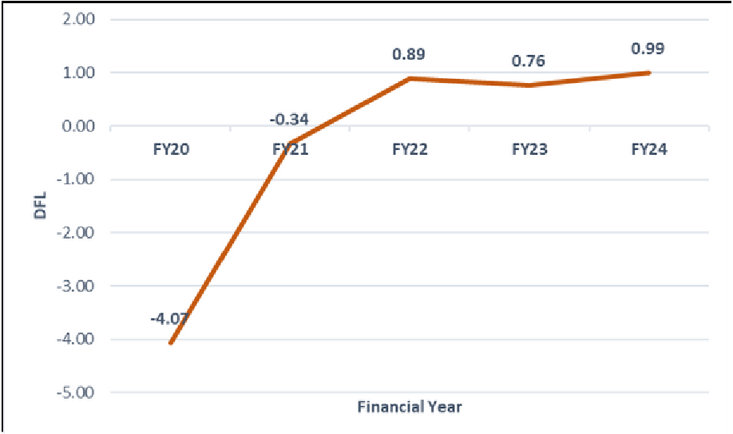


LEVERAGE ANALYSIS USING DOL & DFL
Degree of Operational Leverage
Degree of Financial Leverage
Degree of Total Leverage
 |  | Trend: DTL was highly positive in FY20 and FY21, turned negative in FY22, and stabilized positively in FY23 and FY24. Interpretation: High initial DTL indicated significant volatility in net income. The negative DTL in FY22 suggests restructuring, while the positive DTL in later years reflects balanced leverage management, leading to stable net income growth relative to sales changes.
FY20
FY21 FY22 FY23 FY24
-6.86
-70.7
-2.79
1.81
16.37
Trend: DOL fluctuated from highly negative in FY20 and FY21 to positive in FY23 and FY24.
Interpretation: The initial negative DOL values indicated high sensitivity and operational instability. The shift to positive DOL values reflects improved operational efficiency, better cost management, and reduced sensitivity of operating income to sales changes.
FY20
FY21 FY22 FY23 FY24
-4.07
-0.34
0.89
0.76
0.99
Trend: DFL moved from negative in FY20 and FY21 to positive values from FY22 to FY24.
Interpretation: Negative DFL values indicated high financial instability. The transition to positive DFL values suggests improved financial management, reduced debt impact, and greater stability in net income relative to operating income changes.
FY20
FY21 FY22 FY23 FY24
27.92
23.97
-2.50
1.38
16.17
MRF Ltd. experienced significant volatility in operational and financial performance in FY20 and FY21, as indicated by highly negative DOL and DFL values and high DTL. This reflects sensitivity to economic disruptions and high fixed costs. From FY22 onwards, improvements in DOL, DFL, and DTL suggest successful restructuring, better cost management, and improved financial stability. The company has effectively reduced its sensitivity to sales fluctuations, leading to a more resilient financial position.
BITS Pilani, Hyderabad Campus

Slide 10

Weighted Average Cost of Capital
Beta
Calculated covariance between stock market data of the firm and the market (NIFTY 50 Index)
Calculated variance of the stock market data for the index
Divided the results obtained in step 1) and 2) to obtain the beta
Cost of Equity
Found the 10 year government bond yield in India to get the risk free rate of return
Took the Market Risk Premium as 8% (as mentioned during
the lecture sessions)
Applied the CAPM model to obtain the Cost of Equity
Cost of Debt
Found out the credit rating for the firm from ICRA's official rating report
Since a recent corporate bond was not available for the
firm, we took the bond yield for a corporate bond of the same rating
4) Calculated the post-tax cost of debt after incorporating for
taxes
Weights
Weights were taken as per Total Assets and Total Liabilities
WACC was calculated after taking the weighted averages of the cost of equity and cost of debt

Slide 11




ESG Performance
Moderate ESG Risk: MRF Ltd. needs to improve its management of ESG risks to reduce potential business impacts.
Lagging Industry Performance: MRF's ESG performance trails behind competitors like Pirelli and Bridgestone, indicating a need for more robust practices.
Global Average: MRF's global ranking is average, highlighting the need to enhance ESG standards for better investor appeal.
Focus Areas: Improvement in environmental
sustainability, social responsibility, and governance is crucial for risk reduction and performance enhancement.
Benchmarking Leaders: Adopting best practices from industry leaders can help MRF improve its ESG ratings and market position.

